Slide 1

Tenant Rights and Obligations
Prepared for University of Windsor International Student Association
March 19, 2018
Nazli Farahmand

Slide 2
Today…
Rental Scam
Residential Tenancy Act
The Landlord and Tenant Board (LTB)
Tenancy Agreement
Tenant Rights and Responsibilities
Landlord Rights and Responsibilities
Maintenance Issues
Who Are Roommates?

Slide 3




Finding a Place
Be aware of fraudulent advertisements
$700/month

Slide 4

How to Protect Yourself
Be aware of red flags.
Search the rental address on kijiji and craiglist to ensure it's not a duplicate post.
However, a duplicate post does not mean it is automatically a scam.
Scammer refuses showings.
When searching for rentals, go to the address. Schedule a showing and confirm its availability.
Before transferring the money to the landlord
Make sure the landlord is legitimate

Slide 5

If you believe you have fallen victim to the “rental scam” Contact Windsor Police Service – 519-255-6700 ext. 4330.
Anonymous tips can be made via Crime Stoppers at 519-258-8477 or www.catchcrooks.com.
You can consider taking legal action against those involved in the fraud or scam.
Law Society Referral Service https://lsrs.lsuc.on.ca/lsrs/ provides 30 minutes of free legal advice.

Slide 6

Residential Tenancies Act
Ontario law.
The “RTA”.
is the law that sets the rules for rent increases, evictions, repairs, and many other issues that affect tenants.

Slide 7
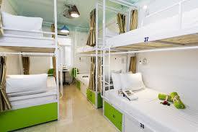

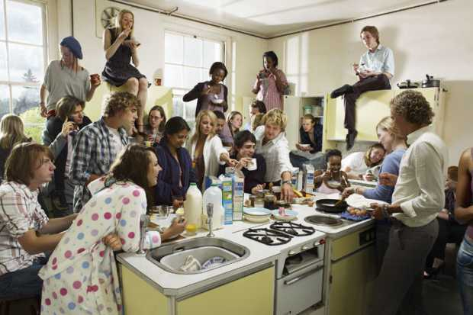


Residential Tenancies Act
RTA does not always apply:
Student residence or dormitories;
Units that are used on a seasonal or temporary basis; or
Those sharing a kitchen or bathroom with their landlord or a member of the landlord’s family

Slide 8
The Landlord and Tenant Board (LTB)
Resolve disputes between landlords and tenants through mediation or adjudication
Provide information to landlords and tenants about their rights and responsibilities.

Slide 9
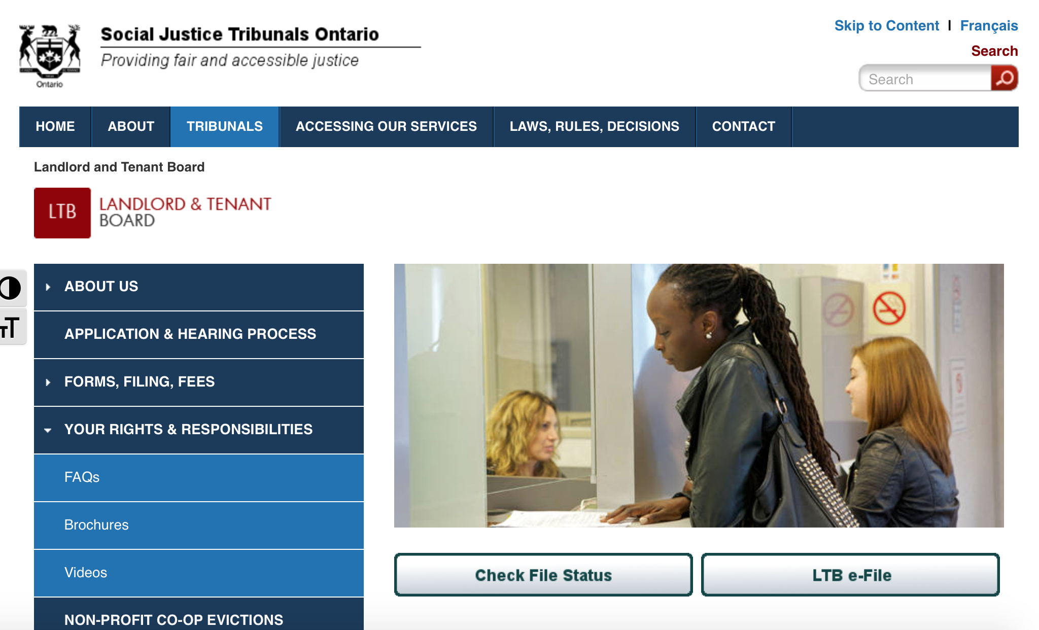
The Landlord and Tenant Board (LTB)
http://www.sjto.gov.on.ca/ltb/
http://www.sjto.gov.on.ca/ltb/

Slide 10
Tenancy Agreement
Lease agreement.
Legal contract between you and your landlord.
Read it carefully and make sure you understand it before signing it

Slide 11
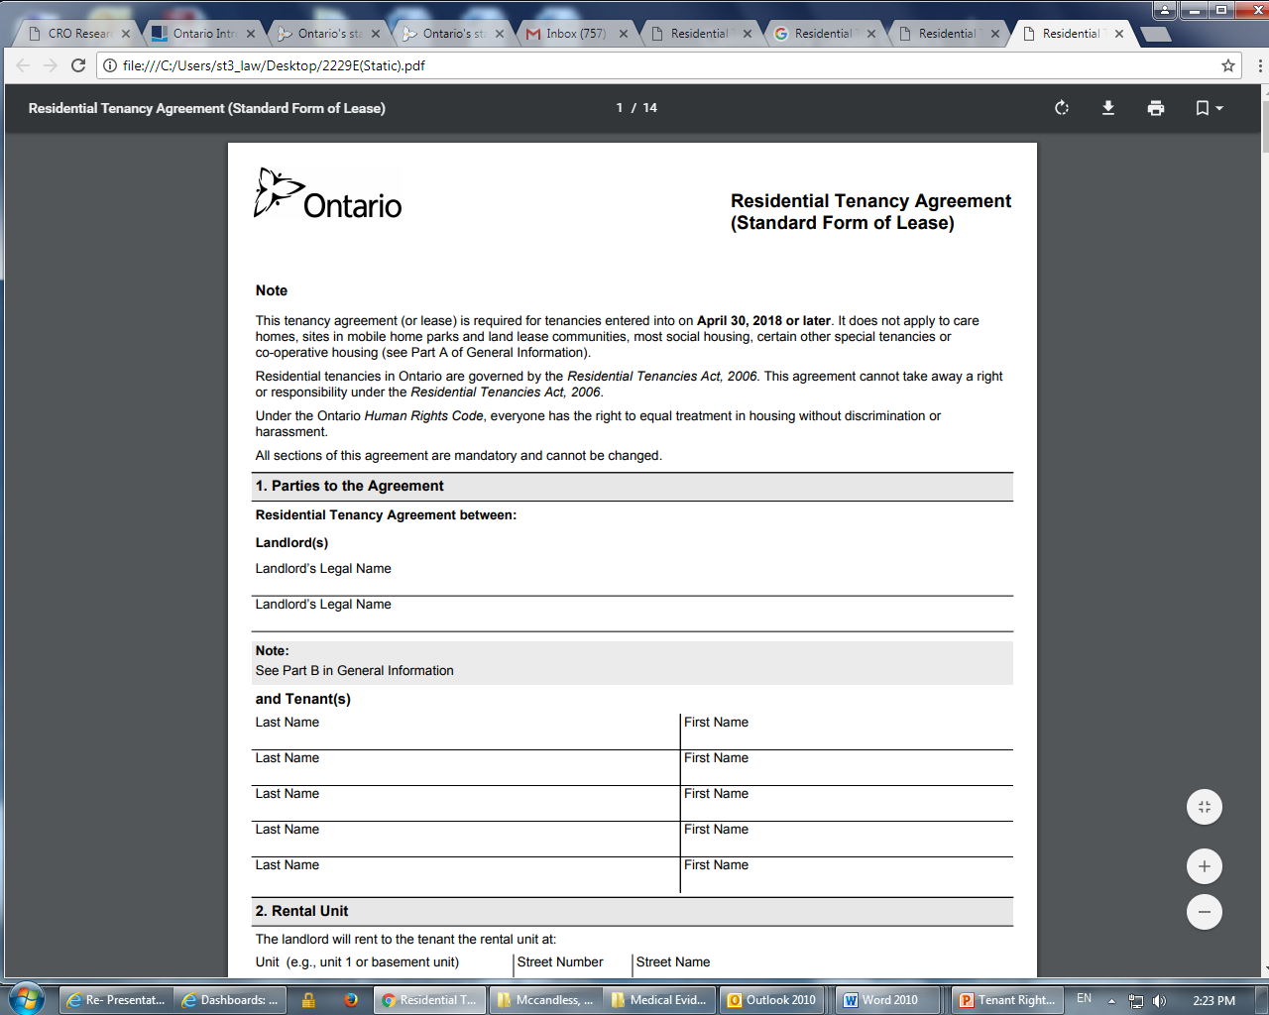

Slide 12


Tenancy Agreement
Lease agreement can have additional terms
Any terms that conflict with the law are invalid.
Invalid terms do not invalidate the lease agreement as a whole.

Slide 13

Read the tenancy agreement carefully.
Seek legal advice
Keep a copy of the tenancy agreement.
Your landlord should provide the tenant with the copy of lease agreement within 21 days after the tenant signs
If landlord refused
the tenant can refuse to pay one month of rent.
Once the landlord provides the tenant with the document(s), the tenant must immediately pay all the rent that they withheld

Slide 14
Tenant Rights and Responsibilities
Tenant is responsible for keeping the unit clean, up to the standard that most people consider ordinary or normal cleanliness
Tenant could be evicted for putting the safety of the landlord or other tenants at risk.
The unit is so dirty that it attracts pests
The unit is so cluttered that it poses a fire hazard

Slide 15

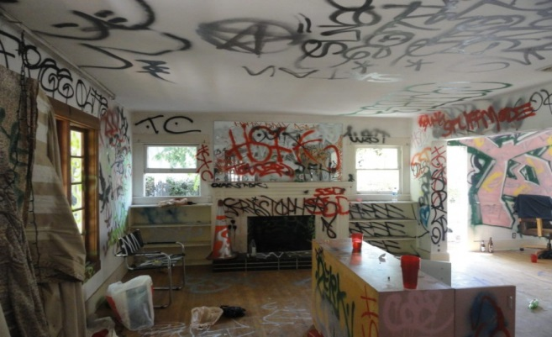
Tenant Rights and Responsibilities
Damages
The tenant is also responsible for repairing or paying for any undue damage to the rental property they caused or caused by their guests or another person living in the rental unit through willful or negligent conduct.
Does not include normal wear and tear
VS
Notes:
Normal wear and tear
Couple of holes in the wall
Faded wallpapers
Darkened carpets and more

Slide 16


Landlord Rights and Responsibilities
It is the landlord's responsibility to maintain the unit in a good state of repair.
Electrical, plumbing or heating system
Appliances
Carpet in the unit or common areas
Walls, roofs, celling and more
The landlord must follow all fire safety laws, property standard by-laws and building codes

Slide 17
When you have a pest or maintenance problem
Keep pictures of the maintenance problem
Put all requests for repairs to the landlord in writing and keep a copy for yourself
Text and emails
Log the dates and times when the you spoke with the landlord

Slide 18

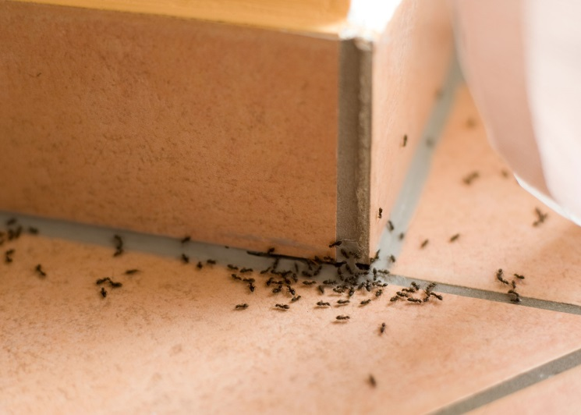
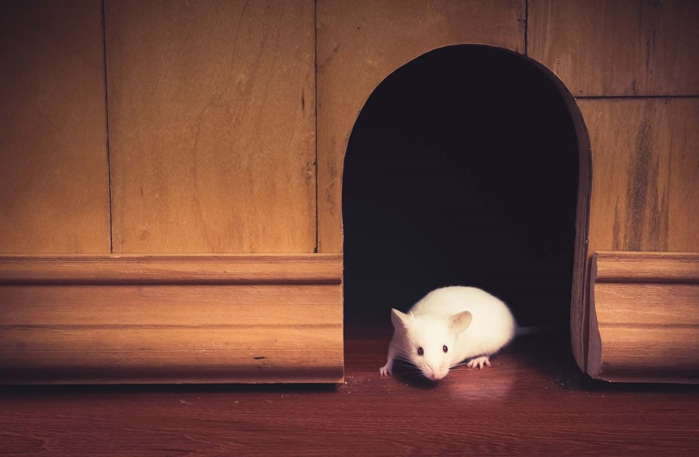
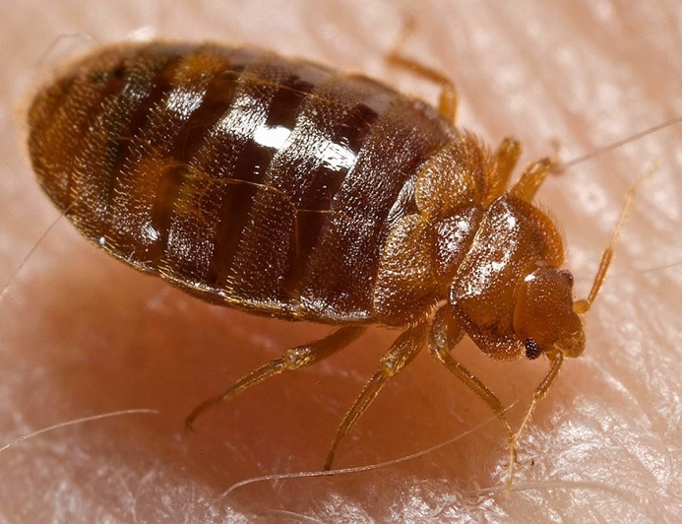
When you have a pest or maintenance problem
Pest Control
The tenant should also cooperate with the landlord with entry and pest control preparation.

Slide 19

If you don’t cooperate…
The landlord can give the tenant notice to end the tenancy.
The notice provides the tenant with 7 days to allow entry and/or prepare for pest control.
The landlord can file an application for eviction.

Slide 20
If you need to discard a piece furniture because it cannot be salvaged due to a pest problem.
You may be able to get compensation for it from LTB.
Do not discard the furniture without a written opinion of licensed professional pest control operator
Inform your landlord in writing
Take pictures of the furniture before discarding it
Value at the time of disposal!

Slide 21


Landlord Refusing to Make Repairs
The landlord does not fix it within a reasonable time, the tenant can:
Report the problem
The tenant can contact the City of Windsor who can send a property standards inspector. That inspector can communicate with the landlord and order the landlord to fix the problem if it violates the City property standards bylaw
Apply to the LTB
tenant can file an application with the LTB.

Slide 22

Do not withhold rent
A tenant should not withhold any part of the rent, even if the tenant feels that maintenance is poor or a necessary repair has not been done.

Slide 23

Who Are Roommates?
No legal definition.
A "roommate", depending on the circumstances, may be:
Joint tenants
Tenants in common
Subtenants
household/"family" members
Guest of the tenants
Notes:
The the word, “roommates” does not have a legal definition by itself-
A "roommate", depending on the circumstances, may be:
Joint tenants
Tenants in common
Subtenants
household/"family" members
Guest of the tenants
Today, we are going to talk about, joint tenants, tenants in common and subtenants only.

Slide 24
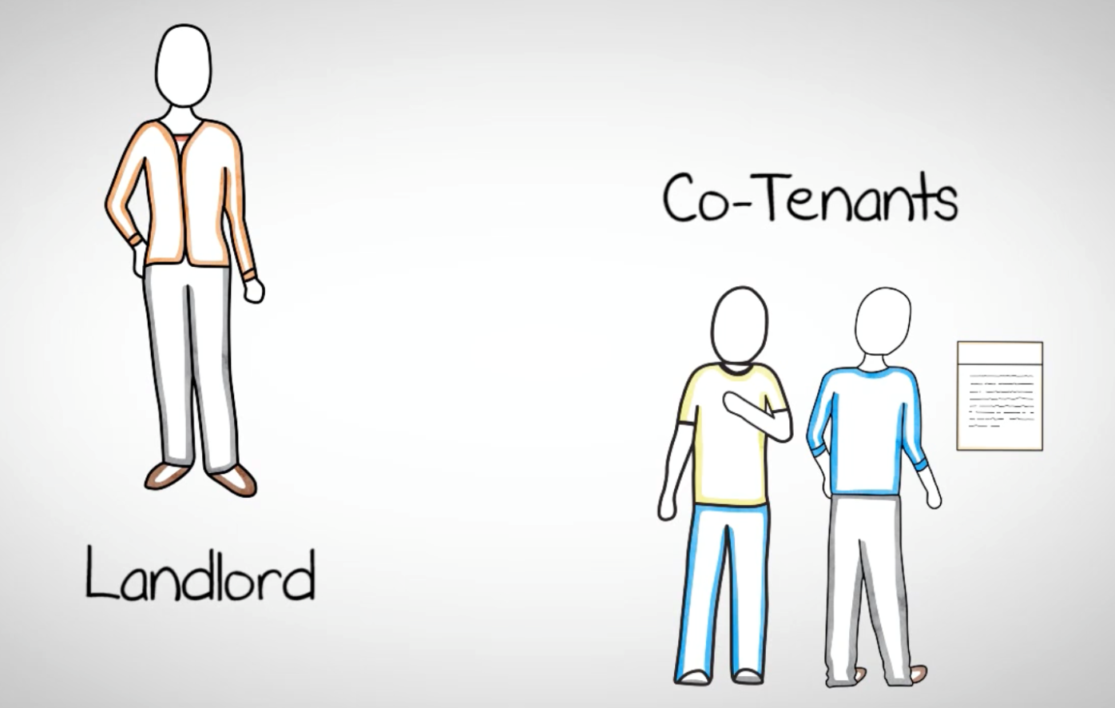
Joint Tenants
Also known as co-tenants
Sign a single tenancy agreement with the landlord
Oral agreement/written agreement
Notes:
Joint- tenants also known as Co-tenants are roommates who together sign a single tenancy agreement with the landlord.
Keep in mind joint-tenancy also can be formed if two or more people verbally agree to jointly enter to tenancy agreement with the landlord.

Slide 25
Joint Tenants
Equal interest in the property.
Meaning that each has an equal right to the property without being restricted to a specific part of it

Slide 26
Joint Tenants
Jointly responsible for all conditions of the tenancy
Together responsible for the full rent, as well as any damage that they cause
If the full rent isn't paid on time, the landlord could make everyone move out, and could also take legal action against any or all of the roommates
Notes:
Jointly responsible for all conditions of the tenancy
Together responsible for the full rent, as well as any damage that they cause
If the full rent isn't paid on time, the landlord could make everyone move out, and could also take legal action against any or all of the roommates
This means that, if your roommate refuses to pay his/her share of rent the landlord is legally able to make you pay for his/her share
Everyone is responsible for any undue damages to the property.

Slide 27
Joint Tenants
Jointly responsible for all conditions of the tenancy
Everyone is responsible for any undue damages to the property and pest control preparation
If one of the roommates did not cooperate, the landlord could also take legal action against any or all of the roommates

Slide 28
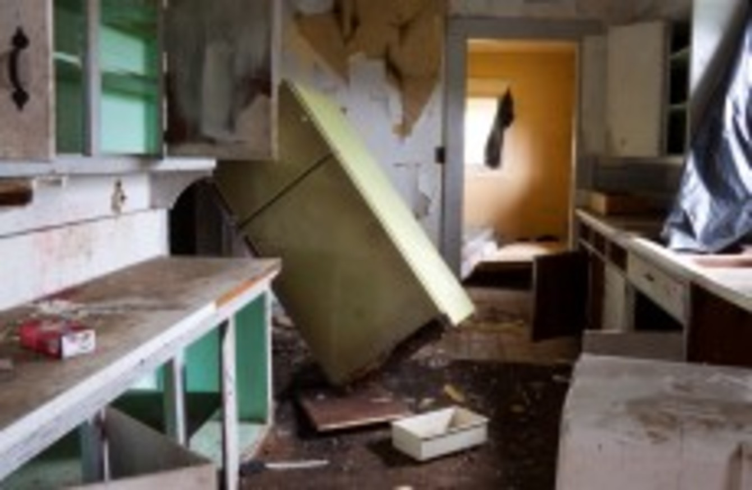
Notes:
For example- if your roommate damages the property both you and your roommate are responsible for any damages and if your roommate refuses to pay or fix the damages, you are responsible for paying for or fixing the damages.

Slide 29
Joint Tenants
If you have any problems with your co-tenants
The landlord does not have any responsibilities to resolve any issues between co-tenants
Any monetary issues can be settled through court

Slide 30

Tenancy in Common
Tenants who live in the same rental unit, but have separate tenancy agreements with the landlord
Notes:
For example, a landlord may rent out individual rooms in a large house to multiple people

Slide 31

Tenancy in Common
In tenancy in common you do not have an equal interest in the property.
You do not have full access to all areas of the property

Slide 32
Tenancy in Common
You are only responsible for your own behavior
If another tenant fails to pay their rent it has no effect on your tenancy
If another tenant damages the property, you don’t have any responsibilities towards the landlord

Slide 33
Summary
Read the lease agreement carefully before signing it.
Seek legal advice.
Ask for a copy of the agreement contract.
Pay your rent on time.
Ask for receipts of payments.
keep your unit clean
Repair any damage to the rental property caused by you or your guests.
You have a right to privacy.
Communicate with your landlord in writing and keep documentation of correspondence.

Slide 34

Educate Yourself
http://www.sjto.gov.on.ca

Slide 35


There is help out there
Community Legal Aid
443 Ouellette Avenue, Suite 200 Windsor, Ontario N9A 4J2
Tel: 519.253.7150
443 Ouellette Avenue, Suite 200
Windsor, Ontario N9A 4J2
Tel: 519.256.7831

Slide 36

Question Time

